Slide 1
The Teddy Bear’s Picnic
Notes:
"Teddy Bears' Picnic" is a song consisting of a melody by American composer John Walter Bratton, written in 1907, and lyrics added by Irish songwriter Jimmy Kennedy in 1932. It remains popular as a children's song, having been recorded by numerous artists over the decades.
From Wikipedia:
http://en.wikipedia.org/wiki/Teddy_Bears'_Picnic

Slide 2
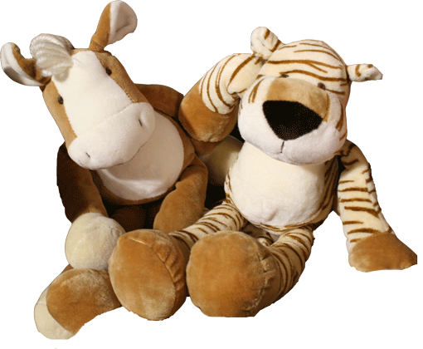
If you go down in the woods today you better not go alone

Slide 3
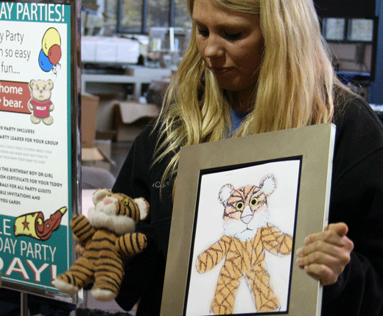
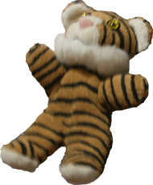
It's lovely down in the woods today but safer to stay at home

Slide 4
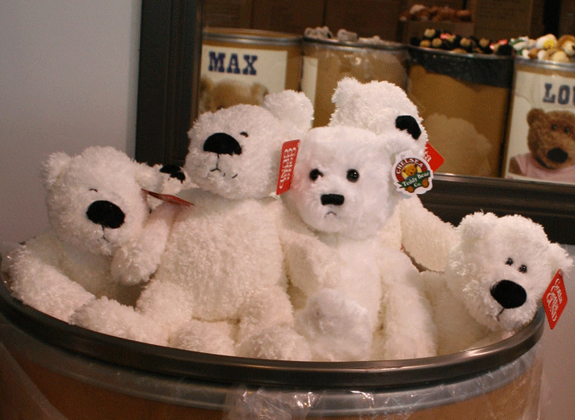
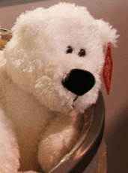
For every bear that ever there was will gather there for certain

Slide 5
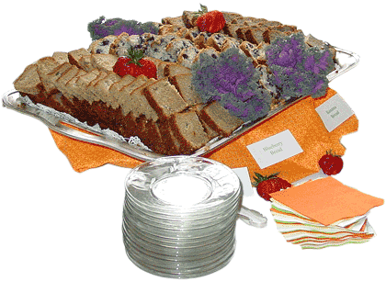
Because today's the day the Teddy Bears have their picnic

Slide 6
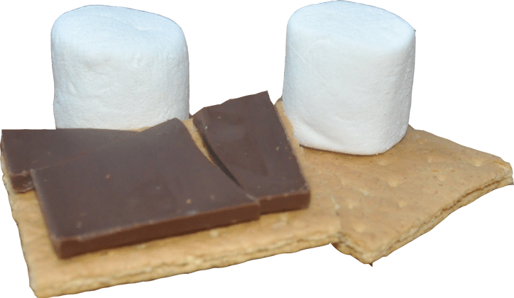
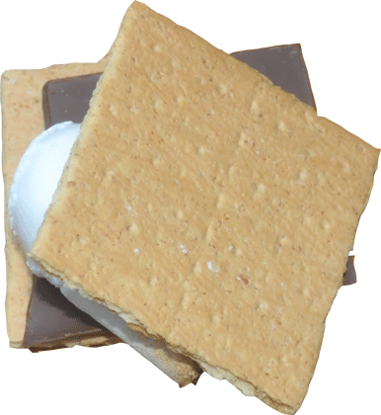
Every Teddy Bear who's been good is sure of a treat today

Slide 7
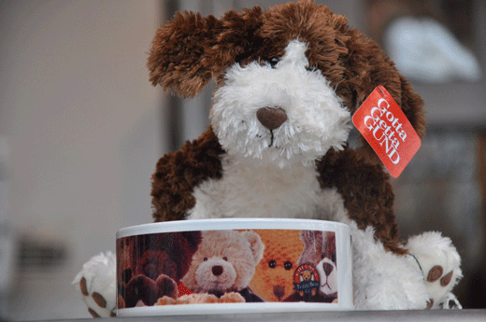
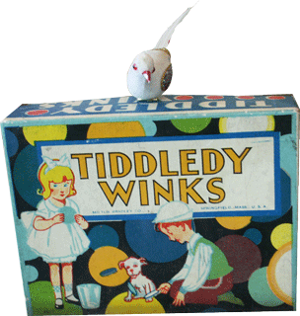
There's lots of marvelous things to eat and wonderful games to play

Slide 8
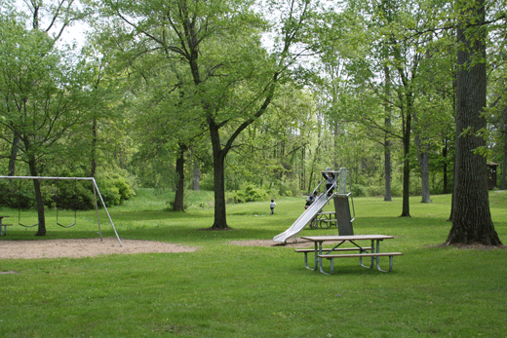
Beneath the trees where nobody sees they'll hide and seek as long as they please

Slide 9
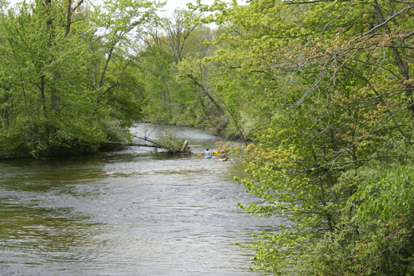
That's the way the Teddy Bears have their picnic

Slide 10
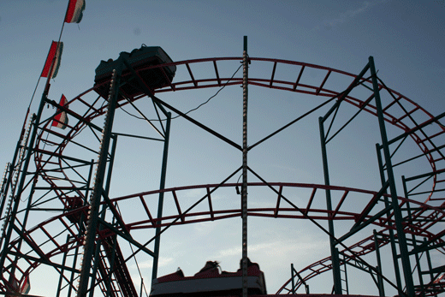
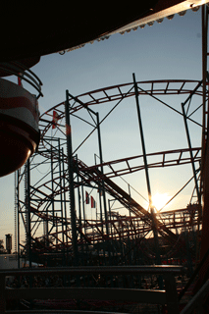
Picnic time for Teddy Bears

Slide 11
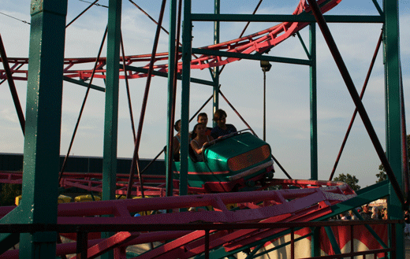
The little Teddy Bears are having a lovely time today

Slide 12
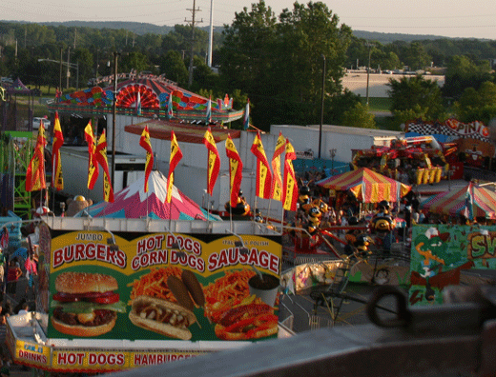
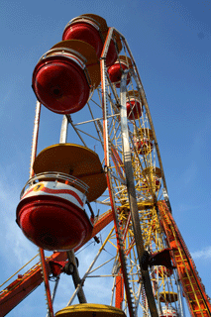
Watch them, catch them unawares and see them picnic on their holiday

Slide 13
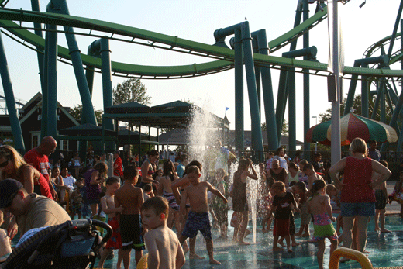
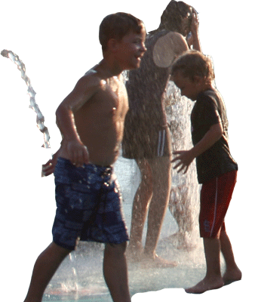
See them gaily gad about

Slide 14
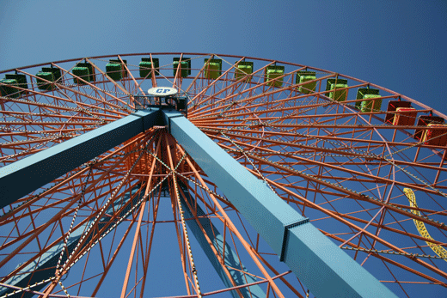
They love to play and shout

Slide 15
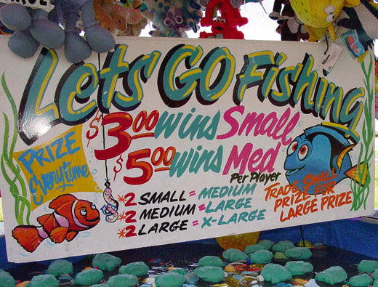
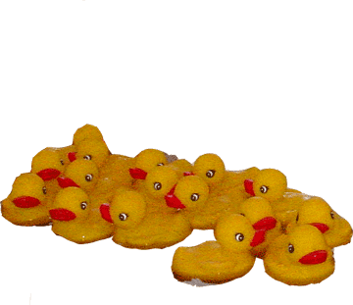
They never have any cares

Slide 16
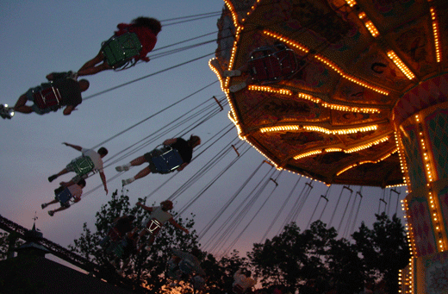
At six o'clock their Mummies and Daddies will take them home to bed

Slide 17
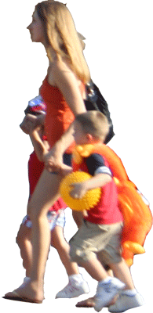
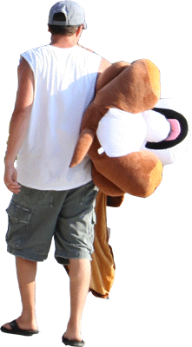
'Cause they're tired little Teddy Bears

Slide 18
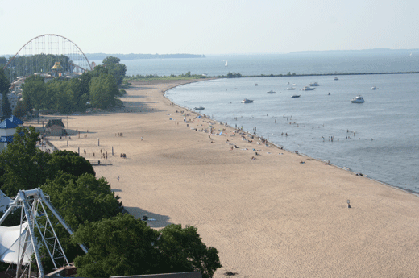
If you go down in the woods today you better not go alone

Slide 19
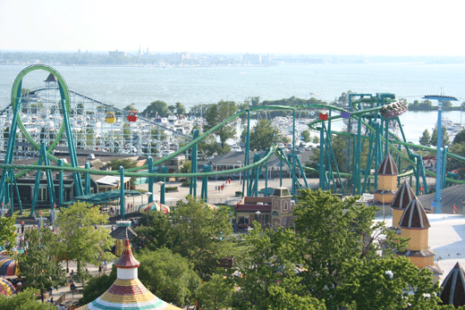
It's lovely down in the woods today but safer to stay at home

Slide 20
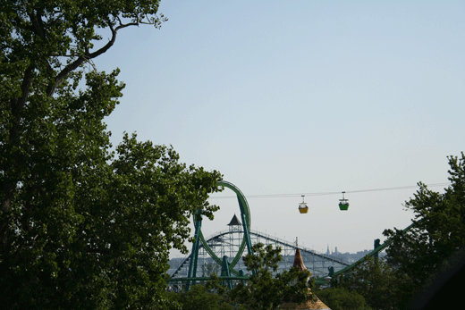
For every bear that ever there was will gather there for certain

Slide 21
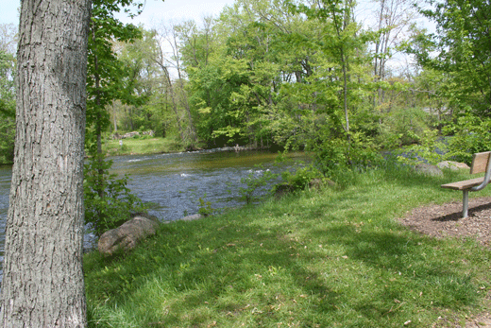
Because today's the day the Teddy Bears have their picnic

